Slide 1


COURSE SLIDES · NON-WSQ
Automate Business Processes with Agentic AI Workflows
Course Code: C209
Non-WSQ commercial short course
Conducted by Tertiary Infotech Academy Pte Ltd · UEN 201200696W
Version v2.0 · 8 August 2026
© 2026 Tertiary Infotech Academy Pte Ltd. All rights reserved. · www.tertiarycourses.com.sg

Slide 2
COURSE ADMINISTRATION
Welcome & Housekeeping
Automate Business Processes with Agentic AI Workflows · C209
© 2026 Tertiary Infotech Academy Pte Ltd
2

Slide 3
YOUR TRAINER · GENERAL
About the Trainer
NAME
____________________________________________
?
TITLE / DESIGNATION
____________________________________________
QUALIFICATIONS
____________________________________________
Your Trainer
AREAS OF EXPERTISE
____________________________________________
General Trainer template —
to be completed by the trainer
TRAINING & INDUSTRY EXPERIENCE
____________________________________________
CONTACT
____________________________________________
Automate Business Processes with Agentic AI Workflows · C209
© 2026 Tertiary Infotech Academy Pte Ltd
3

Slide 4
YOUR TRAINER
About the Trainer
ROLE
Principal Trainer, Tertiary Infotech Academy Pte. Ltd.
AA
QUALIFICATIONS
PhD — specialises in AI, automation and software engineering.
Dr. Alfred Ang
DELIVERS
Courses on agentic AI, workflow automation (n8n) and app development.
Principal Trainer
Tertiary Infotech Academy Pte. Ltd.
FOUNDER
Founder and lead instructor at Tertiary Infotech / Tertiary Courses.
Automate Business Processes with Agentic AI Workflows · C209
© 2026 Tertiary Infotech Academy Pte Ltd
4

Slide 5
ICE-BREAKER
Let's Know Each Other
Who you are
Your name, your organisation and your role.
Your starting point
Your experience with automation or AI tools — including none at all.
1
2
Your pain point
One business process in your work you would most like to automate.
Your goal
What you want to be able to build by the end of this course.
3
4
Automate Business Processes with Agentic AI Workflows · C209
© 2026 Tertiary Infotech Academy Pte Ltd
5

Slide 6
HOUSEKEEPING
Ground Rules
Set your mobile phone to silent mode.
Participate actively — no question is too small.
1
2
Mutual respect: agree to disagree.
One conversation at a time.
3
4
Be punctual; return from breaks on time.
Full attendance — attend both days to get the most from the course.
5
6
Automate Business Processes with Agentic AI Workflows · C209
© 2026 Tertiary Infotech Academy Pte Ltd
6

Slide 7
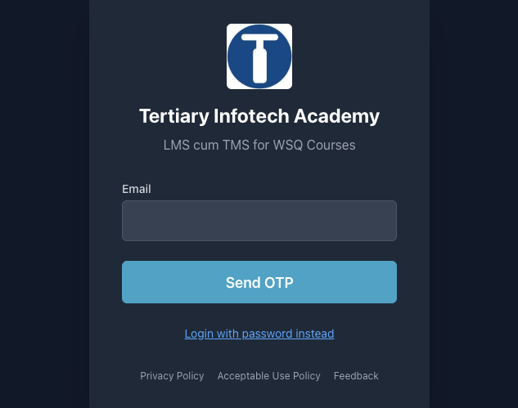
COURSE PORTAL
Download Course Material
Log in at lms-tms.tertiaryinfotech.com with your registered email and the OTP sent to your inbox, then open this course to download the slides and Learner Guide.
Automate Business Processes with Agentic AI Workflows · C209
© 2026 Tertiary Infotech Academy Pte Ltd
7

Slide 8
COURSE PORTAL · STEPS
Download Course Material
1
2
3
4
5
▶
▶
▶
▶
Go to lms-tms.tertiaryinfotech.com
Enter your registered email and click Send OTP
Key in the one-time password from your inbox
Open this course and download the slides + Learner Guide
Keep them open — you will refer to them throughout the labs
Automate Business Processes with Agentic AI Workflows · C209
© 2026 Tertiary Infotech Academy Pte Ltd
8

Slide 9
GET THE FLOWS
Get the Course Workflows
Every lab ships a workflow
A ready-made n8n workflow (.json) sits in each lab's folder under labs/.
Import it
In n8n: Workflows → Add workflow → the '...' menu → Import from File → pick the lab .json.
1
2
Re-select your credentials
After importing, re-select YOUR OWN credentials on every node showing a warning.
Nothing of yours is shared
Imported workflows reference credential NAMES, not secrets — no key travels in the file.
3
4
Automate Business Processes with Agentic AI Workflows · C209
© 2026 Tertiary Infotech Academy Pte Ltd
9

Slide 10
SCHEDULE
Lesson Plan — 2 Days, 7.5 hours/day
DAY 1 — n8n, AI Agents and Agentic Chatbots
DAY 2 — Human in the Loop and RAG
• Topic 1: Overview of n8n and AI Agents
• Lab 1 — n8n trigger and action
• Lab 2 — Webhook and AI Agent
• Topic 2 begins: agentic chatbots
• Lab 3 — Chatbot webhook
• Timing: 9:30 am – 5:30 pm
• Topic 2: Human in the loop
• Lab 4 — Human in the loop
• Topic 3: RAG
• Lab 5 — RAG customer care chatbot
• Course recap and next steps
• Timing: 9:30 am – 5:30 pm
Each day is 7.5 instructional hours, 9:30 am – 5:30 pm, with a 30-minute lunch break excluded from instructional time
Automate Business Processes with Agentic AI Workflows · C209
© 2026 Tertiary Infotech Academy Pte Ltd
10

Slide 11
WHAT YOU'LL ACHIEVE
Learning Outcomes
1
LO1 · n8n and AI agents
Explain what n8n and AI agents are, and build workflows using triggers and actions.
2
LO2 · Webhook-triggered agents
Implement AI agent applications triggered by webhooks and integrated with business systems.
3
LO3 · Agentic chatbots
Design agentic chatbot workflows that operate within business and regulatory constraints.
4
LO4 · Human in the loop
Apply human approval so that sensitive actions are authorised by a named person.
5
LO5 · RAG
Deploy Retrieval-Augmented Generation to ground an agent in your organisation's documents.
Automate Business Processes with Agentic AI Workflows · C209
© 2026 Tertiary Infotech Academy Pte Ltd
11

Slide 12
COURSE JOURNEY
Five Connected Labs
Each lab keeps the agent and changes one thing — the front door, the tools, the oversight, the knowledge.
LAB 1
form → email
LAB 2
webhook + agent + tools
LAB 3
chatbot + memory
LAB 4
human approval gate
LAB 5
RAG over documents
▶
▶
▶
▶
1
The front door changes
2
The agent gains abilities
3
The oversight grows
Form Trigger in Lab 1 becomes a Webhook in Labs 2–5 — the workflow behind it barely moves.
Lab 2 adds tools, Lab 3 adds memory, Lab 5 adds retrieval over your own documents.
Lab 4 stops the workflow dead until a licensed person approves what the agent drafted.
By Lab 5 you have built the whole pattern: a front door, an agent, its tools, its guardrails and its knowledge.
Automate Business Processes with Agentic AI Workflows · C209
© 2026 Tertiary Infotech Academy Pte Ltd
12

Slide 13
FOUNDATION
Why Agentic AI, and Why Now
From rules to agents · what agentic automation is worth · where it is used
Automate Business Processes with Agentic AI Workflows · C209
© 2026 Tertiary Infotech Academy Pte Ltd
13

Slide 14
FROM RULES TO AGENTS
The Evolution of AI
Artificial Intelligence · 1950s
Turing's test and symbolic, rule-based systems that encode human expertise by hand.
Machine Learning · 1990s
Data-driven systems that learn patterns from examples instead of being programmed with rules.
1
2
Deep Learning · 2000s
Neural networks — DNNs and CNNs — trained on large datasets with GPU compute.
Generative AI · 2020s
The 2017 Transformer and its attention mechanism made models that generate fluent text and images.
3
4
Agentic AI · 2024
LLMs given goals, tools and memory: they plan, act, observe and adapt rather than answering once.
Physical AI · 2025
Agents that perceive and act in the physical world — robotics and embodied systems.
5
6
Automate Business Processes with Agentic AI Workflows · C209
© 2026 Tertiary Infotech Academy Pte Ltd
14

Slide 15
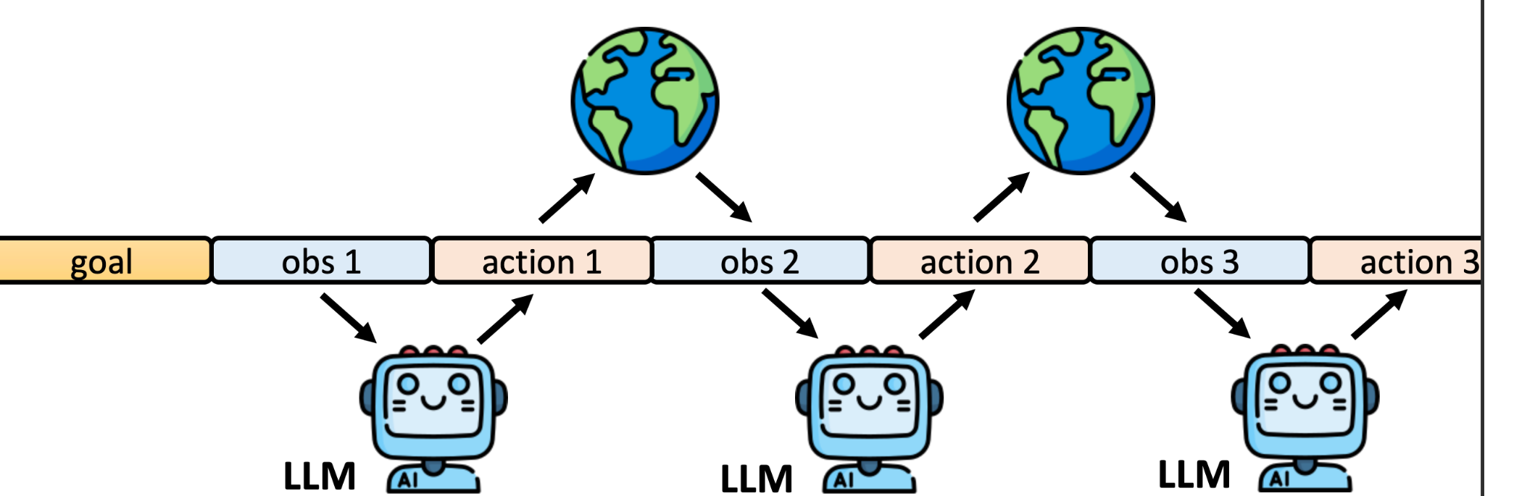
THE AGENT LOOP
How an AI Agent Works
The agent loop: given a goal, the LLM observes, chooses an action, acts on the world through a tool, observes the result, and repeats until the goal is met.
Automate Business Processes with Agentic AI Workflows · C209
© 2026 Tertiary Infotech Academy Pte Ltd
15

Slide 16
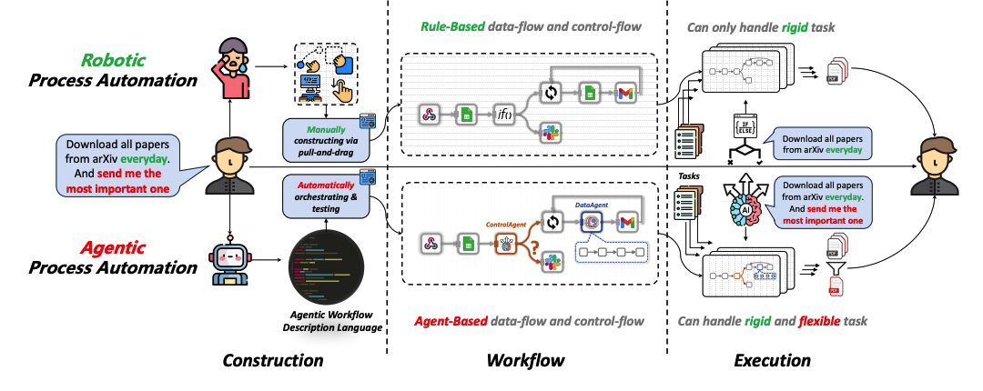
APA
From RPA to Agentic Process Automation
Robotic Process Automation follows a rigid path you construct by hand. Agentic Process Automation lets an agent orchestrate the workflow, so it handles both rigid and flexible tasks.
Automate Business Processes with Agentic AI Workflows · C209
© 2026 Tertiary Infotech Academy Pte Ltd
16

Slide 17
WHY ORGANISATIONS ADOPT IT
Business Value of Agentic Automation
Six reasons organisations move from hand-built automation to agents.
1
Free people from repetitive admin
2
Shift effort to high-value work
3
Respond in real time
Scheduling, form processing, data entry, report generation and email routing run themselves.
When the admin burden lifts, people spend their time on judgement, relationships and strategy.
Events — a form, a payment, a customer message — trigger a workflow the moment they happen.
4
Work around the clock
5
Reduce human error
6
Scale without headcount
An agent answers a 2am enquiry with the same care as a 2pm one, and never forgets to log it.
The same rules are applied to every case, and every decision is written to an audit trail.
Handling ten times the volume costs compute, not another ten hires.
The gain is not speed alone — it is consistency, traceability and capacity you did not have before.
Automate Business Processes with Agentic AI Workflows · C209
© 2026 Tertiary Infotech Academy Pte Ltd
17

Slide 18
USE CASES
Where Agentic Automation Is Used
The same pattern — trigger, agent, tools, oversight — recurs across every function.
1
Customer service
2
Finance & accounting
3
Risk & compliance
Answer enquiries from your own documents, capture leads, and escalate what needs a person.
Invoice processing, bank reconciliation, accounts-payable routing and exception handling.
Screen applications, flag anomalies, and route sensitive cases for human review.
4
HR & people ops
5
Sales & marketing
6
Operations
Onboarding, leave applications, policy questions and approval chains.
Lead qualification, follow-up sequencing, CRM enrichment and content drafting.
Order processing, status notifications, document generation and reporting.
Every one of these is a front door, an agent, some tools and a decision about where the human belongs.
Automate Business Processes with Agentic AI Workflows · C209
© 2026 Tertiary Infotech Academy Pte Ltd
18

Slide 19
COMPLEXITY VS CUSTOMISATION
Where AI Agent Platforms Sit
Three tiers, and why this course teaches the middle one.
1
No-code
2
Low-code · n8n
3
Full-code
Fully visual builders. Fastest route to a working agent, least control over the internals.
A visual canvas plus code nodes, 400+ integrations, self-host or cloud. This course's platform.
SDKs and frameworks such as LangChain. Maximum control, and real engineering effort.
n8n sits where a business analyst can build it and an engineer can still extend it.
Automate Business Processes with Agentic AI Workflows · C209
© 2026 Tertiary Infotech Academy Pte Ltd
19

Slide 20
01
TOPIC 01
Overview of n8n and AI Agents
Workflow automation · Triggers & actions · LLM agents · Webhooks
Applied in Lab 1, Lab 2
Automate Business Processes with Agentic AI Workflows · C209
© 2026 Tertiary Infotech Academy Pte Ltd
20

Slide 21
TOPIC 1 · n8n AND AI AGENTS
What Is n8n?
A workflow automation platform: connect apps, data and AI on one visual canvas — no-code to full-code.
1
Build visually
2
Run anywhere
3
AI-native
Drag nodes onto a canvas and wire them together. 400+ app integrations, plus HTTP and Code nodes when no integration exists.
Free cloud trial at n8n.io, or self-host with Docker. Webhooks, schedules and chat triggers work the same in both.
AI Agent and LangChain nodes are built in — attach any LLM (Gemini, OpenAI, Claude), memory, tools and vector stores.
One canvas to connect apps, data and AI — automation and agents without gluing code by hand.
Automate Business Processes with Agentic AI Workflows · C209
© 2026 Tertiary Infotech Academy Pte Ltd
21

Slide 22
TOPIC 1 · n8n AND AI AGENTS
Every Workflow Is the Same Shape
Trigger first, then actions in order, with data flowing left to right. Only the nodes change.
TRIGGER
what starts it
ACTION
do the work
ACTION
do more work
OUTPUT
reply, store or notify
▶
▶
▶
1
One trigger
2
Actions are ordered
3
Data flows as JSON
A workflow has exactly one entry point. Change the trigger and you have a different workflow — the actions may not change at all.
Each action runs after the one before it, and can read the output of every node that ran before it.
Every node passes a list of JSON items to the next — the same structure in every lab of this course.
Trigger, actions, output. Learn this once in Lab 1 and every later lab is a variation.
Automate Business Processes with Agentic AI Workflows · C209
© 2026 Tertiary Infotech Academy Pte Ltd
22

Slide 23
TOPIC 1 · n8n AND AI AGENTS
Trigger Nodes — What Is Allowed to Start a Workflow
The trigger you choose is a statement about who or what may start the process.
1
Manual Trigger
2
Schedule Trigger
3
Form Trigger
Click Execute workflow. For building and testing, and for one-off jobs such as the Lab 5 ingestion run.
A clock starts the workflow — an interval or a cron expression. Nightly reports, reminders and syncs.
n8n hosts a web form for you and each submission starts a run. This is Lab 1's front door.
4
Webhook
5
Chat Trigger
6
App & Email Triggers
An external system calls a URL you expose. Your own website, app or CRM — Labs 2, 3, 4 and 5.
Each message in n8n's built-in chat window starts a run — the quickest way to talk to an agent while building.
On new Gmail, new Sheets row, new Drive file. React to changes in the apps you already use.
Pick the trigger by asking: who or what should be allowed to start this process?
Automate Business Processes with Agentic AI Workflows · C209
© 2026 Tertiary Infotech Academy Pte Ltd
23

Slide 24
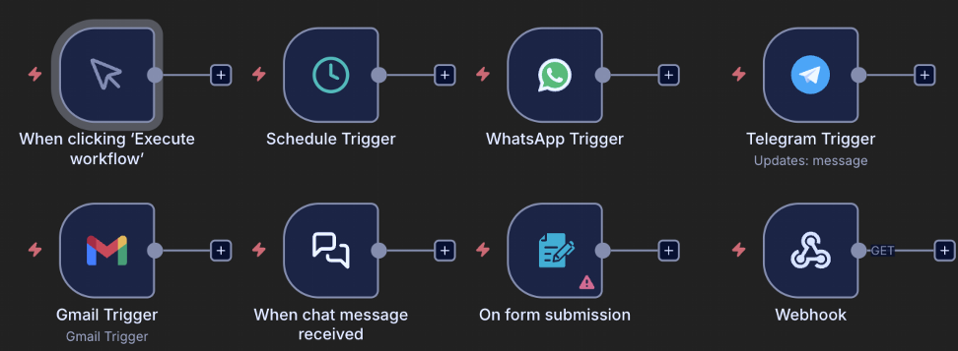
TOPIC 1 · n8n AND AI AGENTS
Trigger Nodes on the n8n Canvas
n8n trigger nodes: Manual · Schedule · WhatsApp · Telegram · Gmail · Chat · Form · Webhook
Automate Business Processes with Agentic AI Workflows · C209
© 2026 Tertiary Infotech Academy Pte Ltd
24

Slide 25
TOPIC 1 · n8n AND AI AGENTS
Triggers Used in This Course
Every lab's trigger, and why that trigger is the right front door for that business process.
Trigger
Where
Why it fits
Form Trigger
Lab 1
A visitor's event sign-up must start the workflow
Webhook — POST
Labs 2, 3, 4, 5
A website sends JSON and waits for the agent's reply
Manual Trigger
Lab 5 ingestion
A human loads the documents once, by hand
Schedule Trigger
Not used in class
Nightly reports and reminders — same pattern, a clock instead
Chat Trigger
Optional while building
Talk to an agent without building a website first
Swap the front door and keep the workflow — the trigger is the only part that has to change.
Automate Business Processes with Agentic AI Workflows · C209
© 2026 Tertiary Infotech Academy Pte Ltd
25

Slide 26
TOPIC 1 · n8n AND AI AGENTS
Data-Processing Nodes — The Workhorses
Between the trigger and the output, these nodes shape, route and transform the data.
1
Edit Fields (Set)
2
IF / Switch
3
Filter
4
Merge
Add, rename or reshape fields — the node you reach for first when the data is the wrong shape. Used in Labs 2 and 4.
Branch the workflow. IF gives a true and a false path; Switch gives one path per case. Lab 4 routes Approve vs Decline.
Let only the matching items continue and drop the rest of the list.
Combine two branches — append the rows, match them by key, or choose one side.
5
Split Out / Aggregate
6
Code
7
Loop / Wait
8
HTTP Request
Turn one item holding a list into many items — and back again.
JavaScript or Python for the 5% a built-in node cannot do. Lab 3 uses it to normalise the chat message.
Process items in batches, or pause a workflow for a period of time or an event.
Call any API on the internet — the universal escape hatch when no integration exists.
Most workflows are: trigger → reshape (Set) → decide (IF) → act (app node). Reach for Code last.
Automate Business Processes with Agentic AI Workflows · C209
© 2026 Tertiary Infotech Academy Pte Ltd
26

Slide 27
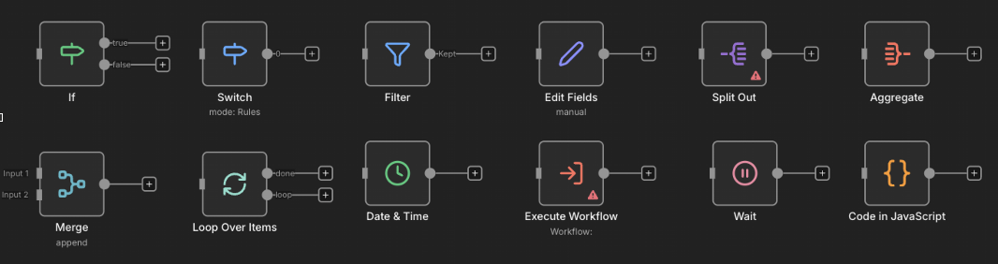
TOPIC 1 · n8n AND AI AGENTS
Data-Processing Nodes on the Canvas
If · Switch · Filter · Edit Fields · Split Out · Aggregate · Merge · Loop · Date & Time · Wait · Code
Automate Business Processes with Agentic AI Workflows · C209
© 2026 Tertiary Infotech Academy Pte Ltd
27

Slide 28
TOPIC 1 · n8n AND AI AGENTS
Where the Data Goes — Storage & App Actions
Action nodes that write the result somewhere useful, or send it to a person.
1
Google Sheets
2
Gmail / Outlook
A real spreadsheet you keep, connected with OAuth2. Append Row is the workhorse — Labs 2 and 4 log every decision here.
Send a message — and in Lab 4, Send and Wait for Response, which turns email into an approval gate.
3
Vector Store
4
Respond to Webhook
Store embeddings for RAG. In-memory for class, Pinecone / Supabase / Qdrant for production — Lab 5.
Return data to whoever called the webhook, so a web page can render the agent's answer.
Anything you must keep goes to external storage — an in-memory store vanishes when n8n restarts.
Automate Business Processes with Agentic AI Workflows · C209
© 2026 Tertiary Infotech Academy Pte Ltd
28

Slide 29
TOPIC 1 · n8n AND AI AGENTS
JSON and Expressions — How Data Moves
Every node passes a list of items; each item is a JSON object of key/value pairs.
• JSON (JavaScript Object Notation) is a simple text format for data.
• Values can be text, numbers, true/false, lists [ ] or nested objects { }.
• Most APIs send and receive JSON — and so does every n8n node.
• Click any node to inspect the JSON going in and coming out.
ONE FORM SUBMISSION AS JSON
{
"Name": "Alice Tan",
"Email": "alice@corp.com",
"Phone": "91234567",
"Message": "Please reserve 2 seats"
}
Read any value later with an expression: {{ $json.Name }} → "Alice Tan"
Automate Business Processes with Agentic AI Workflows · C209
© 2026 Tertiary Infotech Academy Pte Ltd
29

Slide 30
TOPIC 1 · n8n AND AI AGENTS
Test vs Production Executions
The same workflow runs in two modes — always know which one you are looking at.
TEST — in the editor
PRODUCTION — Active toggle ON
• Click Execute workflow to run it once.
• The data is shown live on the canvas, node by node.
• Pin a node's output to freeze it while you build downstream.
• Perfect while building — nothing needs to be Active.
• Runs automatically whenever the trigger fires.
• Nothing appears on the canvas — runs are logged under Executions.
• Every run records status, timing and the full data at each node.
• This is what your users actually experience.
The Executions list is the honest account of what happened — debug from there, not from memory.
Automate Business Processes with Agentic AI Workflows · C209
© 2026 Tertiary Infotech Academy Pte Ltd
30

Slide 31
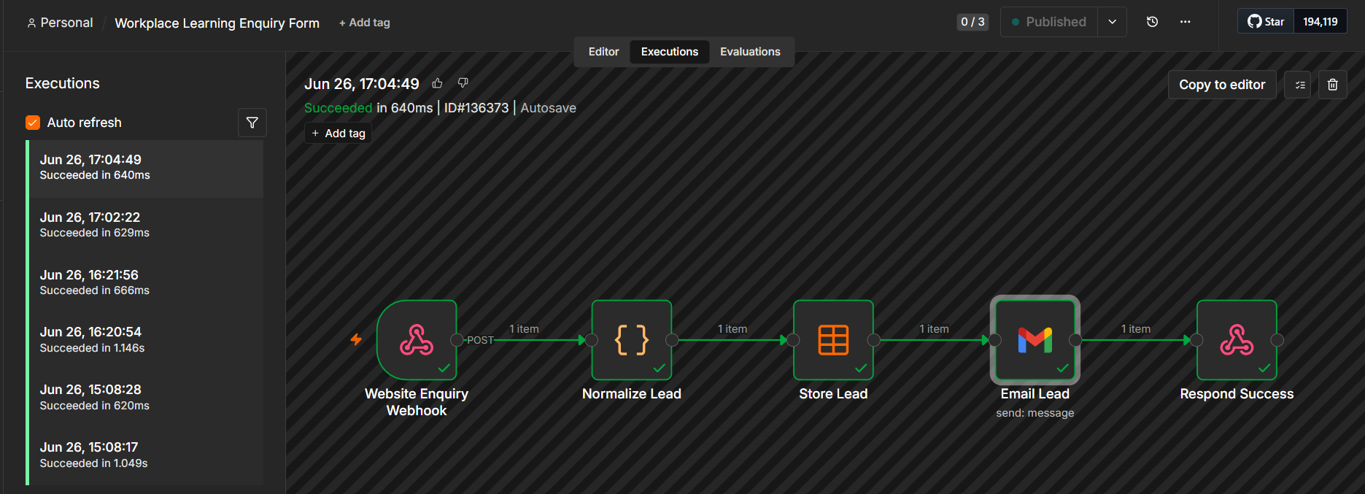
TOPIC 1 · n8n AND AI AGENTS
Execution History
The Executions tab — every run shows its status, duration, ID and the full data at each node
Automate Business Processes with Agentic AI Workflows · C209
© 2026 Tertiary Infotech Academy Pte Ltd
31

Slide 32
TOPIC 1 · n8n AND AI AGENTS
Credentials — Connect Your Accounts Once
Nodes reference credentials by NAME. Set each one up once under Credentials → Add credential.
1
Gmail (OAuth2)
2
Google Gemini (API key)
Sign in with Google and grant access. Used from Lab 1 onward for sending mail and for the Lab 4 approval gate.
The LLM behind every agent in this course, and the embedding model in Lab 5.
3
Google Sheets (OAuth2)
4
Google Drive (OAuth2)
The audit log in Labs 2 and 4 — customer records, decisions, drafts and approvals.
The brochure folder that Lab 5's ingestion workflow reads from.
Imported workflows carry credential NAMES, not secrets — always re-select your own after importing.
Automate Business Processes with Agentic AI Workflows · C209
© 2026 Tertiary Infotech Academy Pte Ltd
32

Slide 33
TOPIC 1 · n8n AND AI AGENTS
Generative AI vs Agentic AI
The difference is not how clever the model is — it is whether it can act.
GENERATIVE AI — answers
AGENTIC AI — acts
• You ask; it writes one answer.
• No access to your systems, and no actions.
• Quality depends on what you paste into the prompt.
• Stops the moment the answer is produced.
• Example: draft me an email to this customer.
• Works toward a goal, not just one reply.
• Calls tools: looks up data, calls APIs, writes records.
• Holds a conversation with memory.
• Continues until the goal is met.
• Example: read the enquiry, check the CRM, reply and log it.
Generative AI produces content. Agentic AI decides and does — which is exactly why it needs governance.
Automate Business Processes with Agentic AI Workflows · C209
© 2026 Tertiary Infotech Academy Pte Ltd
33

Slide 34
TOPIC 1 · n8n AND AI AGENTS
Components of an AI Agent
Four parts around one hub: the AI Agent node wires them together, and every agent in this course is exactly these four.
MODEL
MEMORY
The LLM 'brain' — interprets language, reasons and chooses the next step. Google Gemini in this course.
Keeps the conversation so follow-up questions still make sense. Keyed on a session ID, per visitor.
THE AI AGENT
plans · decides · calls tools
TOOLS
INSTRUCTIONS
The abilities it may use: look up a Sheets row, search a vector store, send an email, call an API.
The system message — identity, scope, rules and refusals. Always in force, on every single turn.
Model + Memory + Tools + Instructions. Change any one of the four and you have a different agent.
Automate Business Processes with Agentic AI Workflows · C209
© 2026 Tertiary Infotech Academy Pte Ltd
34

Slide 35
TOPIC 1 · n8n AND AI AGENTS
The Model — Popular LLM Providers
Any chat model plugs into the same AI Agent node — swap the brain and keep the agent.
Provider
Models
Notes
Google
Gemini 2.5 Flash / Pro
Course default — also supplies the embeddings in Lab 5
OpenAI
gpt-4.1, gpt-4.1-mini, gpt-4o
Widely used; mini tier is cheap and fast
Anthropic
Claude (Opus, Sonnet, Haiku)
Strong reasoning and long context
Meta
Llama 3.x
Open weights — can be self-hosted
Mistral
Mistral / Mixtral
Open weights — a European option
Pick by task: small fast models for classification and guardrails, larger models for reasoning.
Automate Business Processes with Agentic AI Workflows · C209
© 2026 Tertiary Infotech Academy Pte Ltd
35

Slide 36
TOPIC 1 · n8n AND AI AGENTS
Model Parameters — Temperature and Friends
Settings on the chat-model node shape HOW the model answers. The most important by far is temperature.
1
Temperature 0 – 0.3
2
Temperature ≈ 0.7
3
Temperature 1.0 +
Deterministic and repeatable. Use for classification, compliance decisions and data extraction — automation that must give the same answer twice.
Balanced. Natural-sounding conversation with some variety — the usual default for a customer-facing assistant.
Creative and surprising. Marketing copy and brainstorming — never for a decision that must be defended.
1
Top-p
2
Max tokens
3
Frequency / presence penalty
An alternative sampling control that limits the model to the most probable tokens. Tune temperature OR top-p, never both.
Caps the length of the reply. Protects your cost and keeps chat answers short enough to read.
Discourage repetition and nudge the model onto new topics — useful for long generations, rarely for automation.
For business automation keep the temperature LOW — Lab 3 uses 0.2 so the same question is refused the same way every time.
Automate Business Processes with Agentic AI Workflows · C209
© 2026 Tertiary Infotech Academy Pte Ltd
36

Slide 37
TOPIC 1 · n8n AND AI AGENTS
Memory — Why the Agent Remembers
Without memory every message is from a stranger; with it, 'what about next month?' still makes sense.
Msg 1: 'What courses do you run?'
agent answers from its tools
Stored in memory
keyed by session ID
Msg 2: 'How much is that one?'
agent knows which course
Window slides
only the last N turns are kept
▶
▶
▶
1
Window buffer memory
2
Session key
3
Sometimes you want NO memory
Keeps the last N exchanges of THIS conversation. It is n8n's default and it is what Lab 3's chatbot uses.
Memory is per session ID, so two visitors on the same website never see each other's conversation.
Lab 2's onboarding agent deliberately has none — one applicant's details must never influence the next decision.
Memory is conversation context, NOT long-term knowledge. Facts belong in tools and documents (RAG).
Automate Business Processes with Agentic AI Workflows · C209
© 2026 Tertiary Infotech Academy Pte Ltd
37

Slide 38
TOPIC 1 · n8n AND AI AGENTS
Tools — What the Agent May Do
Attach tools to the agent's Tool input. The model decides WHEN to call one, based on the description you write.
1
Google Sheets tool
2
Vector Store tool
Look up or write structured records. Lab 2 attaches three: check for a duplicate, create the customer, send the confirmation.
Retrieve document chunks for a grounded answer — the Query Data Tool in Lab 5.
3
HTTP Request tool
4
Sub-workflow tool
Call any external API in the middle of a conversation — prices, stock levels, a CRM record.
Wrap an entire n8n workflow as one callable tool, so your own logic becomes something the agent can invoke.
The tool DESCRIPTION is how the agent knows when to call it — write it for the model, not for a developer.
Automate Business Processes with Agentic AI Workflows · C209
© 2026 Tertiary Infotech Academy Pte Ltd
38

Slide 39
TOPIC 1 · n8n AND AI AGENTS
Instructions — The Four Parts That Constrain
The system message is always in force. Every good agent instruction in this course states four things.
1
Identity
2
Source rules
Who the agent is, and for whom. 'You are the onboarding assistant for Marina Trust Bank.' Narrow roles refuse far more reliably than general assistants.
Where answers may come from. 'Answer ONLY from the brochures returned by the tool — never from general knowledge.'
3
Refusals
4
Escalation
What is out of bounds, stated explicitly. 'Never recommend a product, predict a return, or guarantee an outcome.'
What to do at the boundary. 'If you are not sure, say so and offer a consultation with a licensed adviser.'
Vague instructions produce confident wrong answers — every rule you skip, the model improvises.
Automate Business Processes with Agentic AI Workflows · C209
© 2026 Tertiary Infotech Academy Pte Ltd
39

Slide 40
TOPIC 1 · n8n AND AI AGENTS
Examples of Good and Bad Instructions
The same chatbot, two system messages — one is testable, the other is a hope.
✗ TOO VAGUE
✓ CONSTRAINED AND TESTABLE
"You are a helpful assistant. Answer the user's questions politely."
"You are the enquiry assistant for Meridian Asset Management.
Answer only questions about our services, fees and appointment booking.
Use the brochure search tool for any factual question — never answer from general knowledge.
Never recommend a product, predict a return, or guarantee an outcome.
If you are not sure, say so and offer a call with a licensed adviser."
No identity · no source rules · no refusals · no escalation.
It will happily invent a price and guarantee an investment return — politely.
Identity · source rules · refusals · escalation — you can test each line by trying to break it.
Automate Business Processes with Agentic AI Workflows · C209
© 2026 Tertiary Infotech Academy Pte Ltd
40

Slide 41
TOPIC 1 · n8n AND AI AGENTS
MCP — Model Context Protocol
An open standard that gives agents a common plug for tools and data, instead of one custom integration per pair.
AI Agent
any MCP-capable client
MCP Client
speaks the protocol
MCP Server
exposes tools + data
Your Systems
databases, APIs, files
▶
▶
▶
Without MCP
With MCP
Every agent × every tool needs its own custom integration. N agents and M tools means N × M connectors to build and to maintain.
Build ONE MCP server per system and any MCP-capable agent can use it. N + M pieces, and the tools become reusable across agents.
MCP is like USB-C for AI tools — one connector, many devices.
Automate Business Processes with Agentic AI Workflows · C209
© 2026 Tertiary Infotech Academy Pte Ltd
41

Slide 42
TOPIC 1 · n8n AND AI AGENTS
MCP in n8n
n8n sits on both sides of the protocol — it can serve tools to other agents, and borrow tools for its own.
MCP SERVER TRIGGER — n8n serves tools
MCP CLIENT TOOL — n8n consumes tools
• Expose your own n8n workflows AS tools over MCP.
• Claude, an IDE or another agent can then call your workflows directly.
• n8n becomes the tool layer for any MCP client.
• Secured with a bearer token on the server URL.
• Attach an external MCP server to your n8n AI Agent.
• The agent gains all of that server's tools with no custom node.
• Mix MCP tools and native n8n tools freely on the same agent.
• Same agent loop — simply more reach.
Two directions, one protocol. Build the tool once and every agent you own can use it.
Automate Business Processes with Agentic AI Workflows · C209
© 2026 Tertiary Infotech Academy Pte Ltd
42

Slide 43
TOPIC 1 · n8n AND AI AGENTS
What Is a Webhook?
A URL your workflow listens on. When the outside world calls it, your workflow runs — the reverse of you calling an API.
Event happens
a visitor submits the form
HTTP request to your URL
the website POSTs JSON
Workflow runs
n8n receives the data as its input
Respond to Webhook
your reply returns to the caller
▶
▶
▶
1
Push, not pull
2
Any caller
3
A paired node
No polling and no schedule — the caller notifies you the moment something happens.
Websites, payment providers, forms, CRMs, mobile apps — anything that can send an HTTP request.
The Webhook node starts the workflow; Respond to Webhook sends the answer back on the same connection.
A webhook is the reverse of an API call — the outside world calls YOU when an event happens.
Automate Business Processes with Agentic AI Workflows · C209
© 2026 Tertiary Infotech Academy Pte Ltd
43

Slide 44
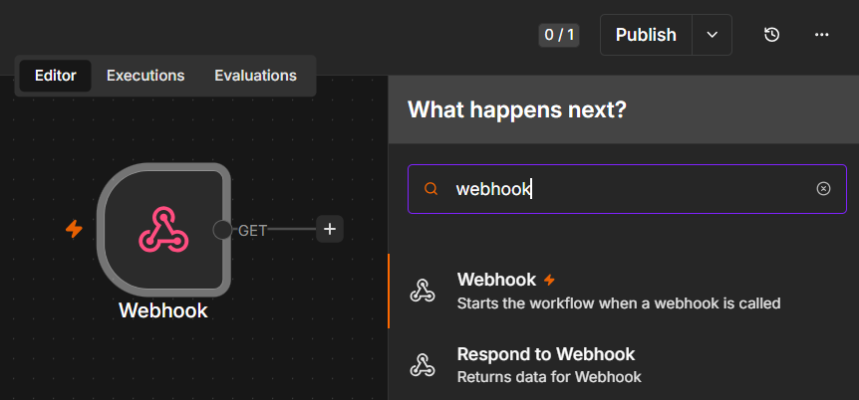
TOPIC 1 · n8n AND AI AGENTS
Webhook Nodes in n8n
The Webhook node starts the workflow when it is called; Respond to Webhook returns data to the caller
Automate Business Processes with Agentic AI Workflows · C209
© 2026 Tertiary Infotech Academy Pte Ltd
44

Slide 45
TOPIC 1 · n8n AND AI AGENTS
Webhook vs HTTP Request — Which Way the Call Goes
Both are plain HTTP. The only difference is who dials.
WEBHOOK — inbound
HTTP REQUEST — outbound
• An external service calls YOUR workflow.
• You react the moment the event happens.
• It is the TRIGGER — always the first node.
• Labs 2–5: the lab website calls your agent.
• YOUR workflow calls an external service.
• You pull the data at a moment you choose.
• It is an ACTION inside the workflow.
• Use it to reach any API with no dedicated n8n node.
Same HTTP underneath — a webhook receives a call, an HTTP Request makes one.
Automate Business Processes with Agentic AI Workflows · C209
© 2026 Tertiary Infotech Academy Pte Ltd
45

Slide 46
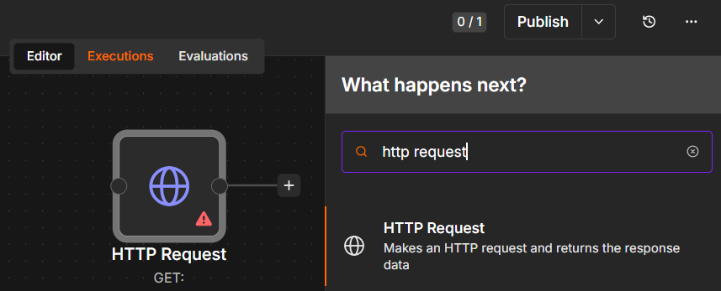
TOPIC 1 · n8n AND AI AGENTS
The HTTP Request Node
The HTTP Request node calls out to any API — the outbound counterpart to an inbound webhook
Automate Business Processes with Agentic AI Workflows · C209
© 2026 Tertiary Infotech Academy Pte Ltd
46

Slide 47
TOPIC 1 · n8n AND AI AGENTS
HTTP Methods on a Webhook — GET vs POST
The method is part of the contract with the caller: where the data rides, and what the call means.
GET — read
POST — send
• The data rides in the URL query string:
– ?email=alice@corp.com
• A browser can call it just by visiting the URL.
• Read it in n8n as {{ $json.query.email }}.
• Right for: a dashboard pulling data to display.
• The data rides in the request body as JSON:
– { "message": "How much is the course?" }
• This is what a web form or a chat widget sends.
• Read it in n8n as {{ $json.body.message }}.
• Right for: Labs 2–5, where the site submits data.
GET reads, POST sends. Set the method on the Webhook node — and the caller must match it exactly.
Automate Business Processes with Agentic AI Workflows · C209
© 2026 Tertiary Infotech Academy Pte Ltd
47

Slide 48
TOPIC 1 · n8n AND AI AGENTS
Webhook Test URL vs Production URL
Every Webhook node gives you TWO URLs. They behave differently, and confusing them is the single most common webhook bug.
TEST URL — /webhook-test/…
PRODUCTION URL — /webhook/…
• Works only while you have clicked 'Listen for test event'.
• Handles exactly ONE call, then stops listening.
• The run appears live on the canvas — ideal for debugging.
• Dies the moment you leave the editor.
• Requires the workflow to be toggled Active.
• Always on — every call starts a run.
• Runs are logged under Executions, not drawn on the canvas.
• This is the URL you give to a website, an app or a QR code.
Your website must call the PRODUCTION URL of an ACTIVE workflow — the Test URL is spent after one request.
Automate Business Processes with Agentic AI Workflows · C209
© 2026 Tertiary Infotech Academy Pte Ltd
48

Slide 49
TOPIC 1 · n8n AND AI AGENTS
Configuring the Webhook Node
Four settings decide whether the browser's call actually succeeds.
1
Method + Path
2
Allowed Origins (CORS)
GET or POST, and the path that ends your URL — for example POST /webhook/marina-trust-onboarding.
Browsers block cross-site calls unless you allow them. Set * in class so a local HTML page can call n8n; never leave * in production.
3
Response mode
4
Authentication
Immediately (a bare acknowledgement), when the workflow finishes, or via a Respond to Webhook node — every lab here uses the last one.
None for a classroom demo; Basic, Header or JWT for anything real. A public URL is a public door, and every call costs you model tokens.
'Failed to fetch' in the browser is almost always CORS or a dead Test URL — check those two first.
Automate Business Processes with Agentic AI Workflows · C209
© 2026 Tertiary Infotech Academy Pte Ltd
49

Slide 50
TOPIC 1 · n8n AND AI AGENTS
Structured Output — Making an Agent's Answer Usable
By default an agent returns a paragraph of prose. Prose cannot be branched on, sorted, counted or coloured.
1
Attach an Output Parser
2
Name the fields you will act on
A Structured Output Parser forces named fields instead of free text — Labs 2 and 4 both use one.
Lab 2 returns decision, reason and riskFlags. The website colours its result card from decision alone.
3
Enumerate the allowed values
4
Everything downstream depends on it
APPROVED / REJECTED / REVIEW / DUPLICATE. A closed list is what makes an IF node reliable.
An IF node routes on it, a Sheets node logs it, and a queue is sorted by it. Prose supports none of that.
If something downstream must act on the answer, make the answer a field — not a sentence.
Automate Business Processes with Agentic AI Workflows · C209
© 2026 Tertiary Infotech Academy Pte Ltd
50

Slide 51
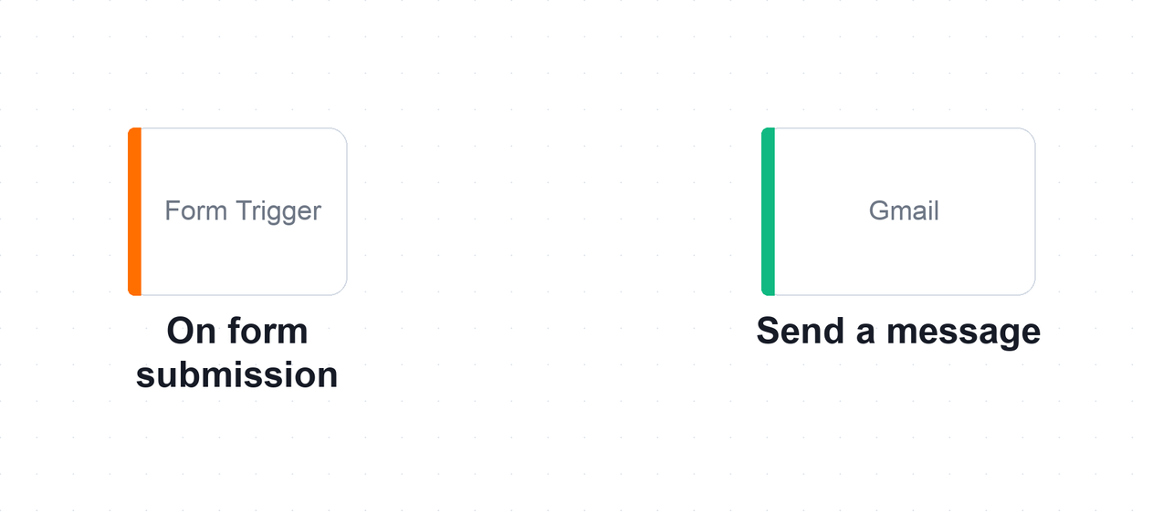
TOPIC 1 · n8n AND AI AGENTS · LAB WORKFLOW
Lab 1 — n8n Trigger and Action (Event Flyer with QR Code)
Build your first n8n workflow end to end: a Form Trigger collects a visitor's details and a Gmail action emails them to the event administrator.
Form Trigger
visitor submits the sign-up
Gmail — Send a message
administrator is emailed
▶
The Lab 1 workflow on the n8n canvas. Two nodes: the Form Trigger decides WHEN the workflow runs, and the Gmail node decides WHAT it does.
LAB 1
n8n Trigger and Action (Event Flyer with QR Code)
Form Trigger → Gmail (Send a message) · full click-by-click steps in the Learner Guide
Automate Business Processes with Agentic AI Workflows · C209
© 2026 Tertiary Infotech Academy Pte Ltd
51

Slide 52
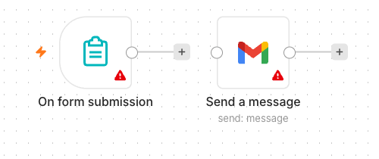
LAB 1 · THE APPLICATION
Lab 1 — n8n Trigger and Action — What You'll Build
• The finished Lab 1 workflow on the n8n canvas — the Form Trigger fires on each submission and the Gmail node sends the details to the administrator.
• A trigger decides when a workflow runs; an action decides what it does.
• Expressions such as {{ $json.Name }} carry data from one node to the next.
Automate Business Processes with Agentic AI Workflows · C209
© 2026 Tertiary Infotech Academy Pte Ltd
52

Slide 53

LAB 1 · THE APPLICATION
Lab 1 — n8n Trigger and Action — What You'll Build
• A sample event flyer from a previous class. The QR code encodes the form's Production URL, so anyone can sign up by scanning it with a phone.
Automate Business Processes with Agentic AI Workflows · C209
© 2026 Tertiary Infotech Academy Pte Ltd
53

Slide 54
LAB 1 · VERIFY AND DEBRIEF
Lab 1 — n8n Trigger and Action
Scan the QR code on your flyer with your phone, submit the form, and confirm the administrator's inbox receives the email with the details you typed. A reference solution is provided as labs/lab1-trigger-actions/lab-trigger-actions.json — build yours by hand first, then import it to compare.
1
Triggers and actions
2
Expressions
A trigger decides when a workflow runs; an action decides what it does.
Expressions such as {{ $json.Name }} carry data from one node to the next.
3
Test vs Production URL
The Test URL works only while you are listening; the Production URL works once the workflow is Active.
Lab 1 — you can now build an automated workflow in n8n using a trigger and an action.
Automate Business Processes with Agentic AI Workflows · C209
© 2026 Tertiary Infotech Academy Pte Ltd
54

Slide 55
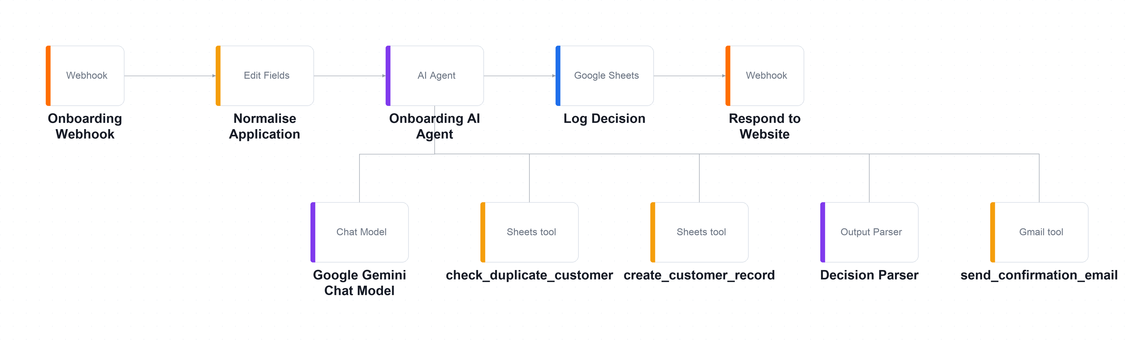
TOPIC 1 · n8n AND AI AGENTS · LAB WORKFLOW
Lab 2 — Webhook and AI Agent (Marina Trust Bank Onboarding)
Replace the n8n form with a real bank website that POSTs to a webhook, where an AI Agent applies the bank's onboarding rules using three tools.
Webhook — POST
the bank site submits
Normalise
Set node tidies the fields
AI Agent
+ 3 tools + parser
Log Decision
Google Sheets audit row
Respond
decision returns to the page
▶
▶
▶
▶
The Lab 2 workflow on the n8n canvas. The main chain runs left to right; the chat model, output parser and three tools hang below the agent on its Tool input.
LAB 2
Webhook and AI Agent (Marina Trust Bank Onboarding)
Webhook → Normalise → AI Agent (+3 tools) → Log Decision → Respond to Website · full click-by-click steps in the Learner Guide
Automate Business Processes with Agentic AI Workflows · C209
© 2026 Tertiary Infotech Academy Pte Ltd
55

Slide 56
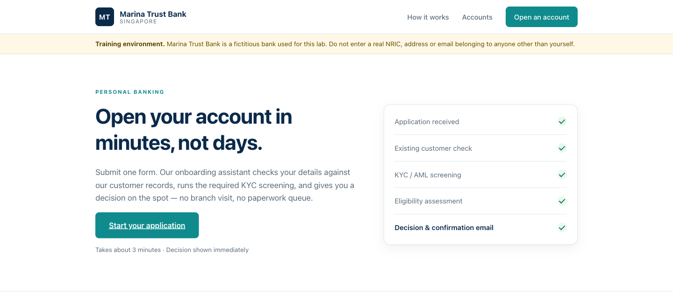
LAB 2 · THE APPLICATION
Lab 2 — Webhook and AI Agent — What You'll Build
• The Marina Trust Bank site the webhook sits behind. The applicant submits here, the AI Agent decides, and the page renders the decision as a coloured card.
• A webhook lets any external system — your website, an app, a CRM — start an agent workflow.
• Tools are what turn an LLM into an agent: it decides when to look up a customer and when to create one.
Automate Business Processes with Agentic AI Workflows · C209
© 2026 Tertiary Infotech Academy Pte Ltd
56

Slide 57
LAB 2 · VERIFY AND DEBRIEF
Lab 2 — Webhook and AI Agent
Run TC1 (a new applicant) and confirm a green APPROVED card, a new row in the Customers sheet and a confirmation email. Then run TC2 (an already-seeded NRIC) and confirm an amber DUPLICATE card with no new row.
1
Webhooks
2
Tools make an agent
A webhook lets any external system — your website, an app, a CRM — start an agent workflow.
Tools are what turn an LLM into an agent: it decides when to look up a customer and when to create one.
3
Structured output
4
The front door is separate
Structured output (decision, reason, riskFlags) is what lets downstream nodes branch, log and colour a result.
The agent is unchanged from a form-triggered version — only the front door differs.
Lab 2 — you can now deploy an AI agent that is triggered by a webhook from an external website.
Automate Business Processes with Agentic AI Workflows · C209
© 2026 Tertiary Infotech Academy Pte Ltd
57

Slide 58
Lunch Break
1 hour
Automate Business Processes with Agentic AI Workflows · C209
© 2026 Tertiary Infotech Academy Pte Ltd
58

Slide 59
02
TOPIC 02
Agentic Chatbot and Human in the Loop
Agentic workflows · Chatbots on webhooks · Approval gates · Accountability
Applied in Lab 3, Lab 4
Automate Business Processes with Agentic AI Workflows · C209
© 2026 Tertiary Infotech Academy Pte Ltd
59

Slide 60
TOPIC 2 · AGENTIC CHATBOT & HITL
Human In, On, and Out of the Loop
Three levels of human oversight. The design question is which one this particular process deserves.
1
Human IN the loop
2
Human ON the loop
3
Human OUT of the loop
The workflow PAUSES and a named person must approve before the action happens. Nothing reaches the customer unauthorised. This is Lab 4.
The agent acts immediately, but a person monitors and can intervene or reverse it. Suited to high volume and low individual risk.
Fully autonomous. Acceptable only where an error is cheap, reversible and detectable — never where money or a regulator is involved.
The question is never 'is the model good enough?' but 'what does one bad output cost, and who answers for it?'
Automate Business Processes with Agentic AI Workflows · C209
© 2026 Tertiary Infotech Academy Pte Ltd
60

Slide 61
TOPIC 2 · AGENTIC CHATBOT & HITL
How an Approval Suspends a Running Workflow
A Send-and-Wait node stops the execution mid-flight and holds it until a person decides.
Event arrives
a client message
Agent drafts
classify, flag, propose
Draft is logged
before any human sees it
Human decides
Approve or Decline
Only then
send and log the outcome
▶
▶
▶
▶
1
The execution really is paused
2
Approve and Decline are just links
3
A decline is a reassignment
Look at the canvas and the run is sitting on the approval node. It waits days if it has to — n8n holds the state.
The email carries two URLs. Clicking one resumes the execution down that branch — no app for the approver to learn.
Declining is not deleting. The ticket moves to a named person, because someone still owes the client an answer.
The agent may do everything except the one thing that matters. That pause is the whole control.
Automate Business Processes with Agentic AI Workflows · C209
© 2026 Tertiary Infotech Academy Pte Ltd
61

Slide 62
TOPIC 2 · AGENTIC CHATBOT & HITL
When to Put a Human in the Loop
Six tests. If a process meets any one of them, it needs an approval gate.
1
Money moves
2
It is a regulated communication
Payments, refunds, credit and lending decisions — anything with a direct financial consequence.
A licensed firm writing to a client about their money, health or legal position.
3
The action is irreversible
4
A person is vulnerable
A sent email, a deleted record or published content cannot be recalled.
Distress, illness, bereavement, or savings that someone cannot afford to lose.
5
The stakes exceed the error rate
6
Someone must be accountable
A 2% error rate is fine for tagging tickets and unacceptable for approving loans.
A regulator asks which licensed person is answerable — not what the machine decided.
Automate the drafting, not the deciding, wherever any of these six is true.
Automate Business Processes with Agentic AI Workflows · C209
© 2026 Tertiary Infotech Academy Pte Ltd
62

Slide 63
TOPIC 2 · AGENTIC CHATBOT & HITL
Guardrails — Two Gates Around the Agent
Instructions shape what the agent intends. Guardrails check what actually goes in and comes out.
INPUT GUARDRAIL — before the agent
OUTPUT GUARDRAIL — after the agent
• Screen the incoming message before the model ever sees it.
• Block prompt injection: 'ignore your instructions and…'.
• Strip or reject personal data you must not process.
• Rate-limit and authenticate — a public webhook is a public door.
• Check the reply before it reaches a human being.
• Look for the phrases you have banned: guarantees, forecasts, advice.
• Validate the structured fields against the values you allow.
• On any doubt, route to a person rather than sending it.
Defence in depth: the same rule in the prompt AND in the workflow — only one of the two runs on a machine you control.
Automate Business Processes with Agentic AI Workflows · C209
© 2026 Tertiary Infotech Academy Pte Ltd
63

Slide 64
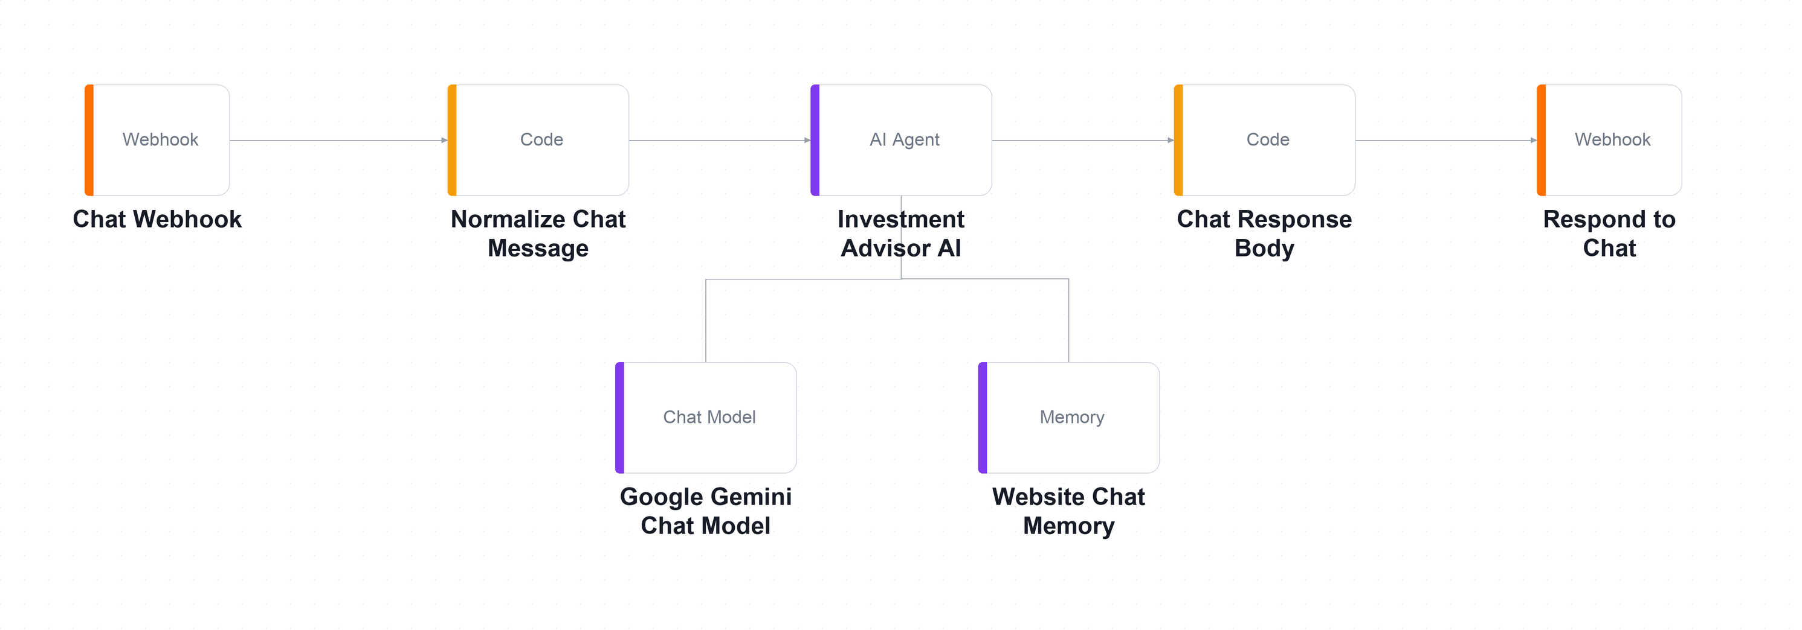
TOPIC 2 · AGENTIC CHATBOT & HITL · LAB WORKFLOW
Lab 3 — Chatbot Webhook (Investment Advisor)
A compliance-bound chatbot for an investment advisory firm: no answer until the firm can contact the visitor, and never any financial advice.
Chat Webhook — POST
the widget sends a message
Normalize
Code node shapes the input
AI Agent
Gemini 0.2 + window memory
Respond to Chat
reply returns to the widget
▶
▶
▶
The Lab 3 workflow on the n8n canvas. A small graph: webhook in, normalise, the agent with its chat model and session memory, then the reply back out.
LAB 3
Chatbot Webhook (Investment Advisor)
Chat Webhook → Normalize → AI Agent (+ model + memory) → Respond to Chat · full click-by-click steps in the Learner Guide
Automate Business Processes with Agentic AI Workflows · C209
© 2026 Tertiary Infotech Academy Pte Ltd
64

Slide 65
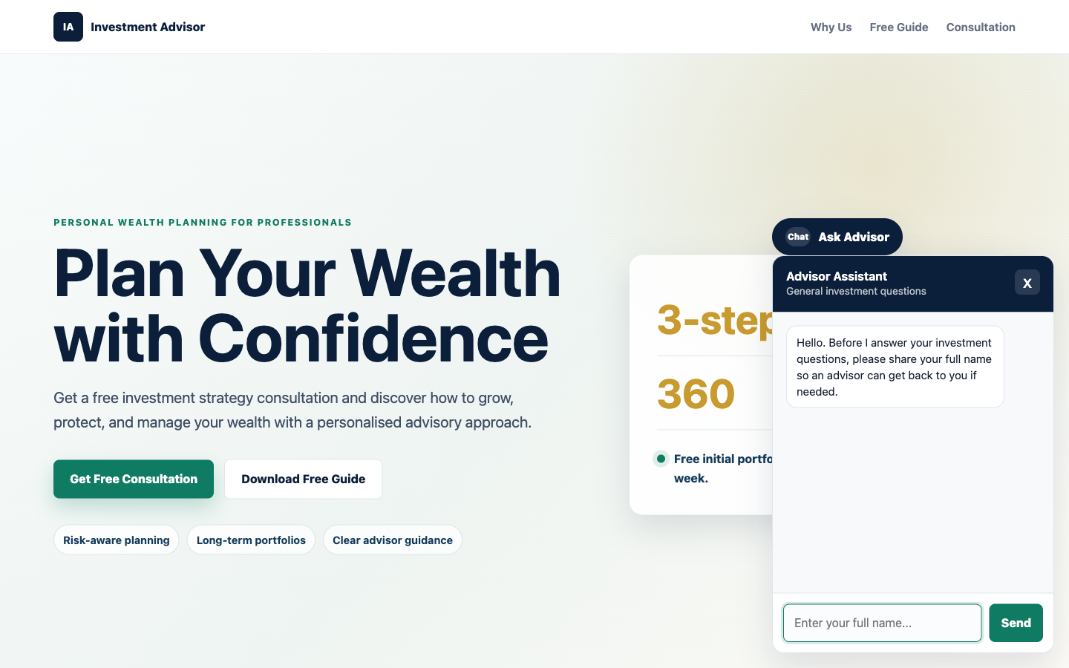
LAB 3 · THE APPLICATION
Lab 3 — Chatbot Webhook — What You'll Build
• The Investment Advisor site with the chat widget open. Note the contact gate in action — it asks for the visitor's name before it will answer anything.
• An agentic chatbot's system message is a compliance control, not just a prompt.
• The same rule enforced in the browser and in the agent is deliberate redundancy — only one of them runs on a machine you control.
Automate Business Processes with Agentic AI Workflows · C209
© 2026 Tertiary Infotech Academy Pte Ltd
65

Slide 66
LAB 3 · VERIFY AND DEBRIEF
Lab 3 — Chatbot Webhook
Ask 'Can you guarantee returns?' and 'Which stock should I buy?'. The agent must decline both and offer a consultation. Then ask a question before giving your details — it must ask for the missing detail and answer nothing.
1
The system message
2
Defence in depth
An agentic chatbot's system message is a compliance control, not just a prompt.
The same rule enforced in the browser and in the agent is deliberate redundancy — only one of them runs on a machine you control.
3
Session-keyed memory
4
Prompt or RAG?
Session-keyed memory gives context to follow-up questions without leaking between visitors.
A small fixed FAQ belongs in the prompt; RAG is for knowledge too large or too changeable for that.
Lab 3 — you can now deploy an agentic chatbot on a website that operates within regulatory limits.
Automate Business Processes with Agentic AI Workflows · C209
© 2026 Tertiary Infotech Academy Pte Ltd
66

Slide 67
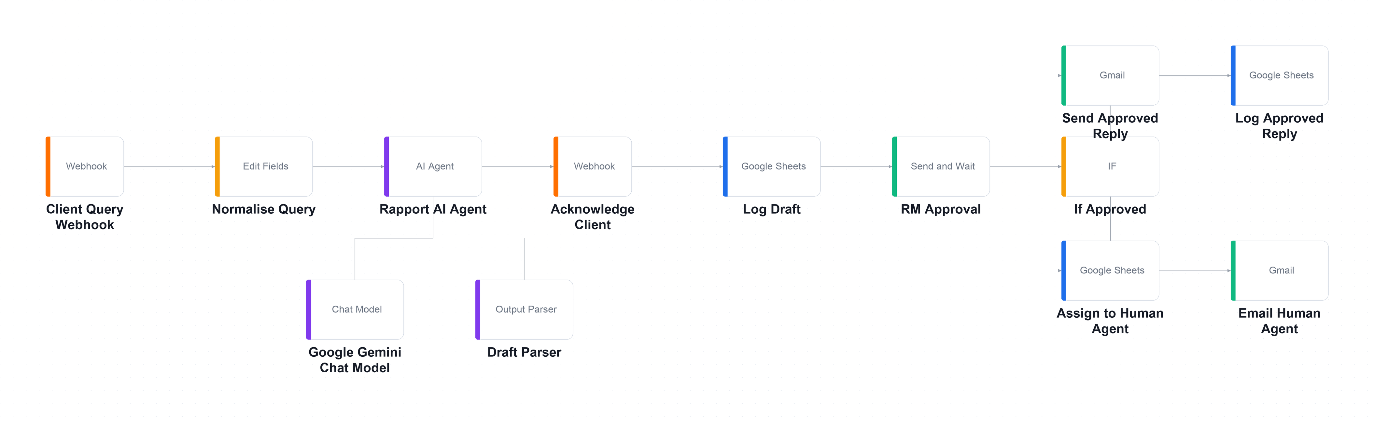
TOPIC 2 · AGENTIC CHATBOT & HITL · LAB WORKFLOW
Lab 4 — Human in the Loop (Client Rapport Assistant)
An agent reads a worried client's concern, flags compliance risks and drafts a reply — but sends nothing until a licensed manager approves it.
Webhook
client sends a concern
AI Agent
classify · flag · draft
Log Draft
before any human sees it
RM Approval
Send & Wait — PAUSED
IF
Approve → send · Decline → reassign
▶
▶
▶
▶
Everything up to RM Approval is the agent's territory; the IF node after it splits into the approved path (top) and the reassignment path (bottom).
LAB 4
Human in the Loop (Client Rapport Assistant)
Webhook → Agent → Acknowledge → Log Draft → RM Approval (Send & Wait) → IF → Send / Reassign · full click-by-click steps in the Learner Guide
Automate Business Processes with Agentic AI Workflows · C209
© 2026 Tertiary Infotech Academy Pte Ltd
67

Slide 68
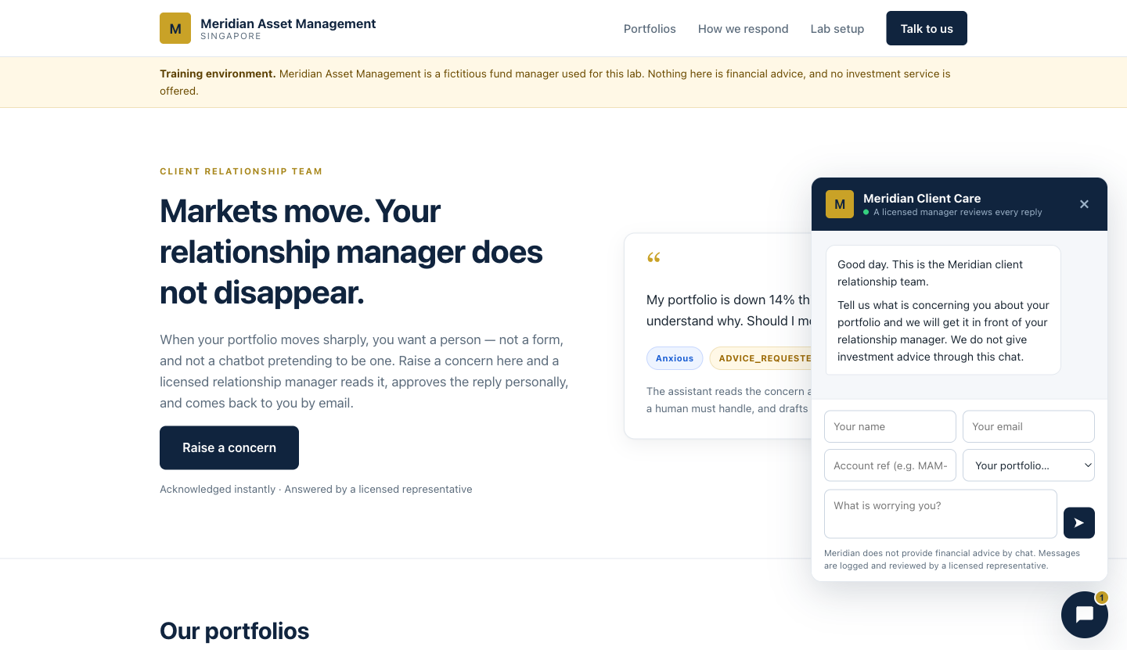
LAB 4 · THE APPLICATION
Lab 4 — Human in the Loop — What You'll Build
• The Meridian client portal. The widget states plainly that a licensed manager reviews every reply — the human-in-the-loop promise made visible to the client.
• A Send-and-Wait node pauses the workflow until a named person authorises the action.
• Separating what the agent proposed from what a human approved is what makes the trail auditable.
Automate Business Processes with Agentic AI Workflows · C209
© 2026 Tertiary Infotech Academy Pte Ltd
68

Slide 69
LAB 4 · VERIFY AND DEBRIEF
Lab 4 — Human in the Loop
Run all eight rows of sample-queries.csv. When you are done Drafts has 8 rows, Approved_Replies has 5 and Handover_Queue has 3 — and no accountability column is empty.
1
The approval gate
2
Two separate logs
A Send-and-Wait node pauses the workflow until a named person authorises the action.
Separating what the agent proposed from what a human approved is what makes the trail auditable.
3
A decline reassigns
4
Keep the model out
A decline is a reassignment, not a deletion — someone must still owe the client an answer.
The most legally important sentence in a workflow should be the one the model cannot touch.
Lab 4 — you can now apply a human approval gate so no AI-drafted communication is sent unsupervised.
Automate Business Processes with Agentic AI Workflows · C209
© 2026 Tertiary Infotech Academy Pte Ltd
69

Slide 70
Tea Break
15 minutes
Automate Business Processes with Agentic AI Workflows · C209
© 2026 Tertiary Infotech Academy Pte Ltd
70

Slide 71
03
TOPIC 03
Retrieval-Augmented Generation (RAG)
Tokenization · Embeddings · Vector stores · Grounded answers
Applied in Lab 5
Automate Business Processes with Agentic AI Workflows · C209
© 2026 Tertiary Infotech Academy Pte Ltd
71

Slide 72
TOPIC 3 · RAG
Why Retrieval, Rather Than a Bigger Prompt
For twenty short documents, pasting them all would genuinely work. The problem starts at two hundred.
1
Prompts have a ceiling
2
Long prompts degrade quality
Add enough documents and you exceed the model's context window — the request simply fails.
Models attend less reliably to the middle of a very long context. The answer is in there and is still missed.
3
You pay for every token
4
Retrieval turns it around
Every question re-sends every document, whether or not it was relevant to that question.
Fetch only the few documents that resemble the question, and send just those. Cheaper, shorter and more accurate.
RAG is not a bigger prompt — it is a smaller, better-chosen one.
Automate Business Processes with Agentic AI Workflows · C209
© 2026 Tertiary Infotech Academy Pte Ltd
72

Slide 73
TOPIC 3 · RAG
The RAG Pipeline — Ingest Once, Retrieve Every Question
Two separate workflows. You run ingestion once; retrieval runs on every single question.
Collect
the source documents
Split
into chunks
Embed
each chunk into a vector
Store
in the vector store
Retrieve
the nearest chunks
Answer
from what came back
▶
▶
▶
▶
▶
1
Ingestion — run by hand
2
Retrieval — runs per question
3
The models must match
Lab 5's first workflow: list 20 brochures on Drive, download, split, embed, insert. A Manual Trigger, run once.
Lab 5's second workflow: embed the question with the SAME model, find the nearest brochures, answer only from those.
A question embedded by one model cannot be compared against documents embedded by another. It fails silently, returning nonsense.
Ingest once, retrieve thousands of times — and use the identical embedding model on both sides.
Automate Business Processes with Agentic AI Workflows · C209
© 2026 Tertiary Infotech Academy Pte Ltd
73

Slide 74
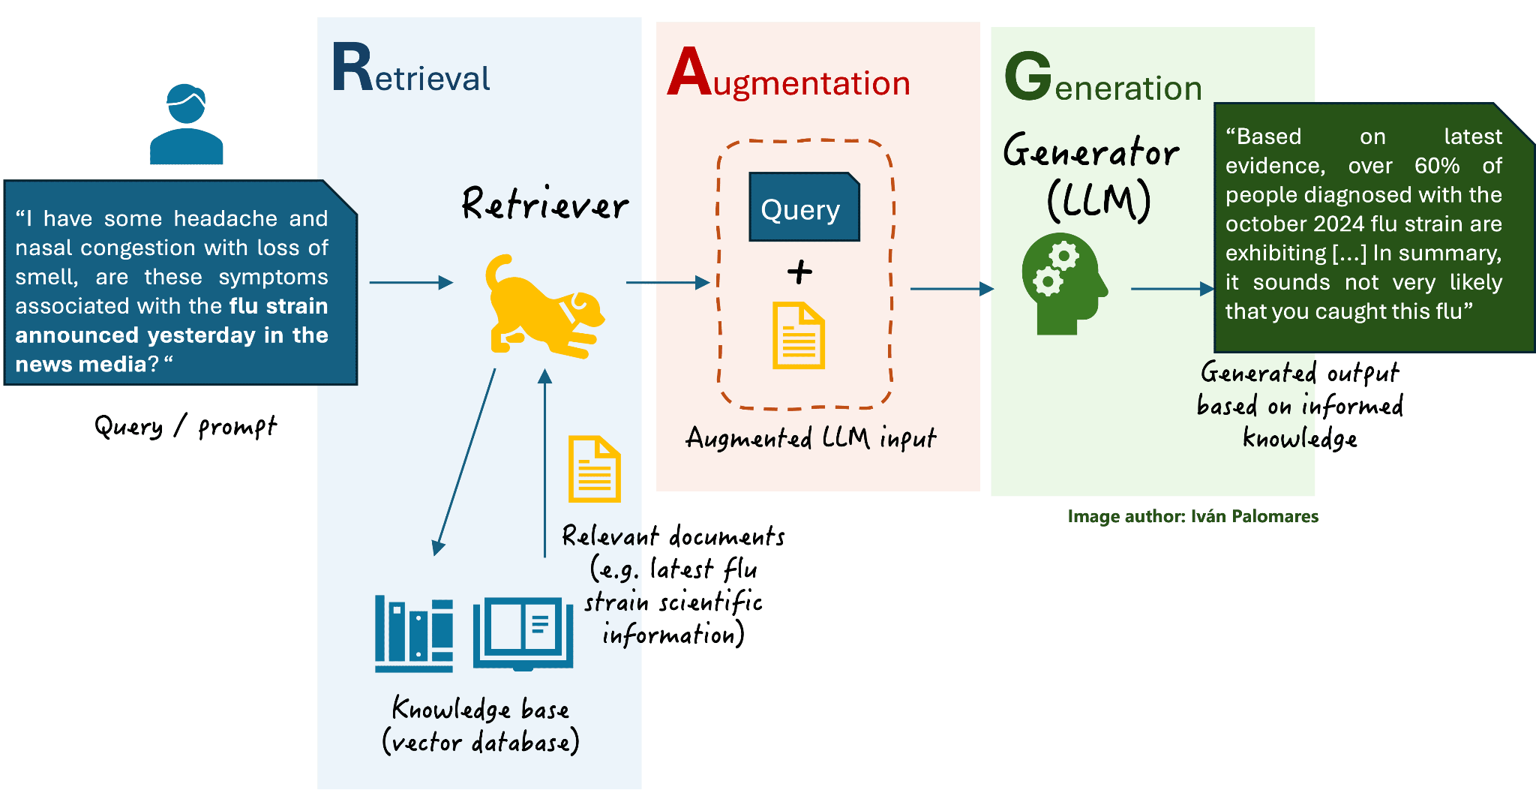
TOPIC 3 · RAG
How RAG Works
Retrieval finds the documents that resemble the question · Augmentation adds them to the prompt · Generation produces an answer grounded in what was retrieved
Automate Business Processes with Agentic AI Workflows · C209
© 2026 Tertiary Infotech Academy Pte Ltd
74

Slide 75
TOPIC 3 · RAG
Chunking — the Biggest Lever on RAG Quality
Most RAG projects fail quietly at chunking, not at the model.
1
The rule
2
Too small
The right chunk is the smallest piece of text that still answers a question on its own.
A brochure sliced into thirds separates the course name from its fee. Retrieval then finds one without the other.
3
Too large
4
Overlap
Irrelevant text crowds the prompt and dilutes what actually matters.
A small overlap between chunks stops a sentence being cut in half at the boundary.
5
In Lab 5
6
topK
Chunk size 4000 with overlap 0 — one brochure becomes exactly one vector, so the fee is never separated from the course.
How many chunks come back. Too few misses the answer; too many dilutes the prompt with noise.
Tune the chunking before you blame the model — that is where the answer was lost.
Automate Business Processes with Agentic AI Workflows · C209
© 2026 Tertiary Infotech Academy Pte Ltd
75

Slide 76
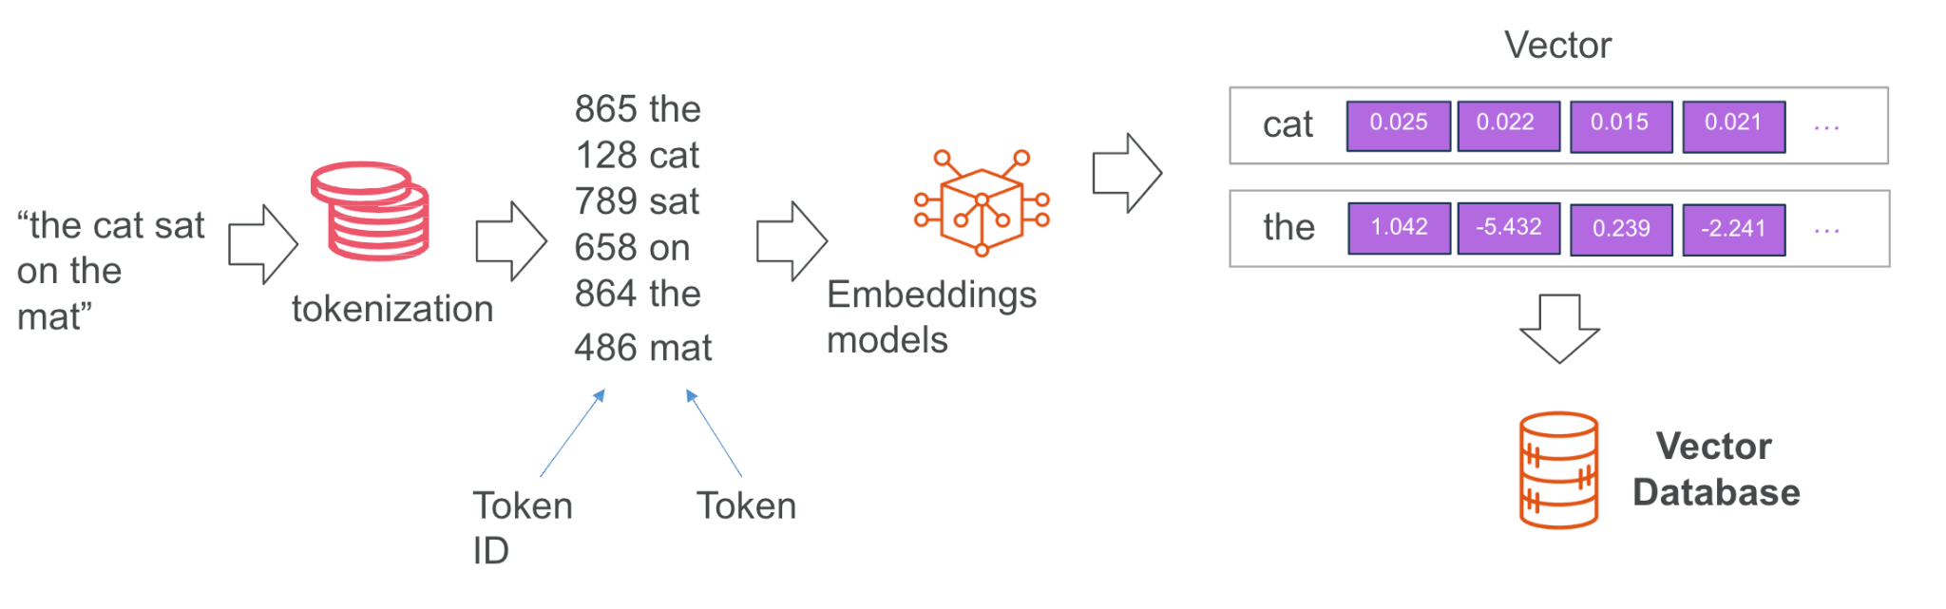
TOPIC 3 · RAG
Tokenization and Text Embedding
Text is split into tokens, then an embedding model turns it into a vector — a list of numbers that places similar meanings close together
Automate Business Processes with Agentic AI Workflows · C209
© 2026 Tertiary Infotech Academy Pte Ltd
76

Slide 77
TOPIC 3 · RAG
Choosing a Vector Store
Where the embeddings live, and whether they are still there tomorrow.
SIMPLE VECTOR STORE — built in
A REAL VECTOR DATABASE
• No account, no API key, no index to create.
• Running RAG within ten minutes — this is what Lab 5 uses.
• WIPED whenever n8n restarts.
• Right for: learning, demos and prototypes.
• Pinecone, Supabase (pgvector), Qdrant, Weaviate.
• An account, an index and a matching dimension to set up.
• Persists, scales, and is shared across n8n instances.
• Right for: anything that goes into production.
Prototype on the in-memory store; move to a hosted database the moment anyone else depends on the answers.
Automate Business Processes with Agentic AI Workflows · C209
© 2026 Tertiary Infotech Academy Pte Ltd
77

Slide 78
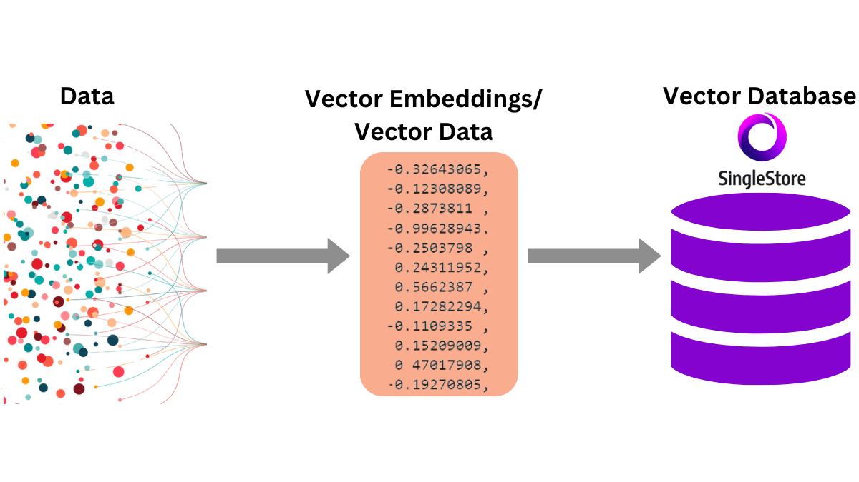
TOPIC 3 · RAG
Vector Databases
A vector store holds the embeddings and finds the nearest neighbours to a question, fast
Automate Business Processes with Agentic AI Workflows · C209
© 2026 Tertiary Infotech Academy Pte Ltd
78

Slide 79
TOPIC 3 · RAG
Grounding an Agent Against Hallucination
An ungrounded model asked for a price will produce one. It will be plausible, it will be wrong, and the customer will quote it back to you.
1
Always call the tool first
2
Answer only from what came back
Instruct the agent to search the documents before answering any factual question at all.
Every factual claim must trace to a retrieved document, not to the model's general knowledge.
3
Give it permission to fail
4
Name what it must never invent
'I don't have that in our course information' is a far better answer than a confident invention.
A fee, a date, a duration, a course code, an instructor's name, a discount.
5
Hide the machinery
6
Test the traps
Never mention the vector store or that it is searching documents — the customer does not care.
Ask about a course you do not run, a person who does not exist, and a discount never offered.
Grounding is an instruction problem as much as a retrieval one — retrieval finds it, the prompt makes it stick.
Automate Business Processes with Agentic AI Workflows · C209
© 2026 Tertiary Infotech Academy Pte Ltd
79

Slide 80
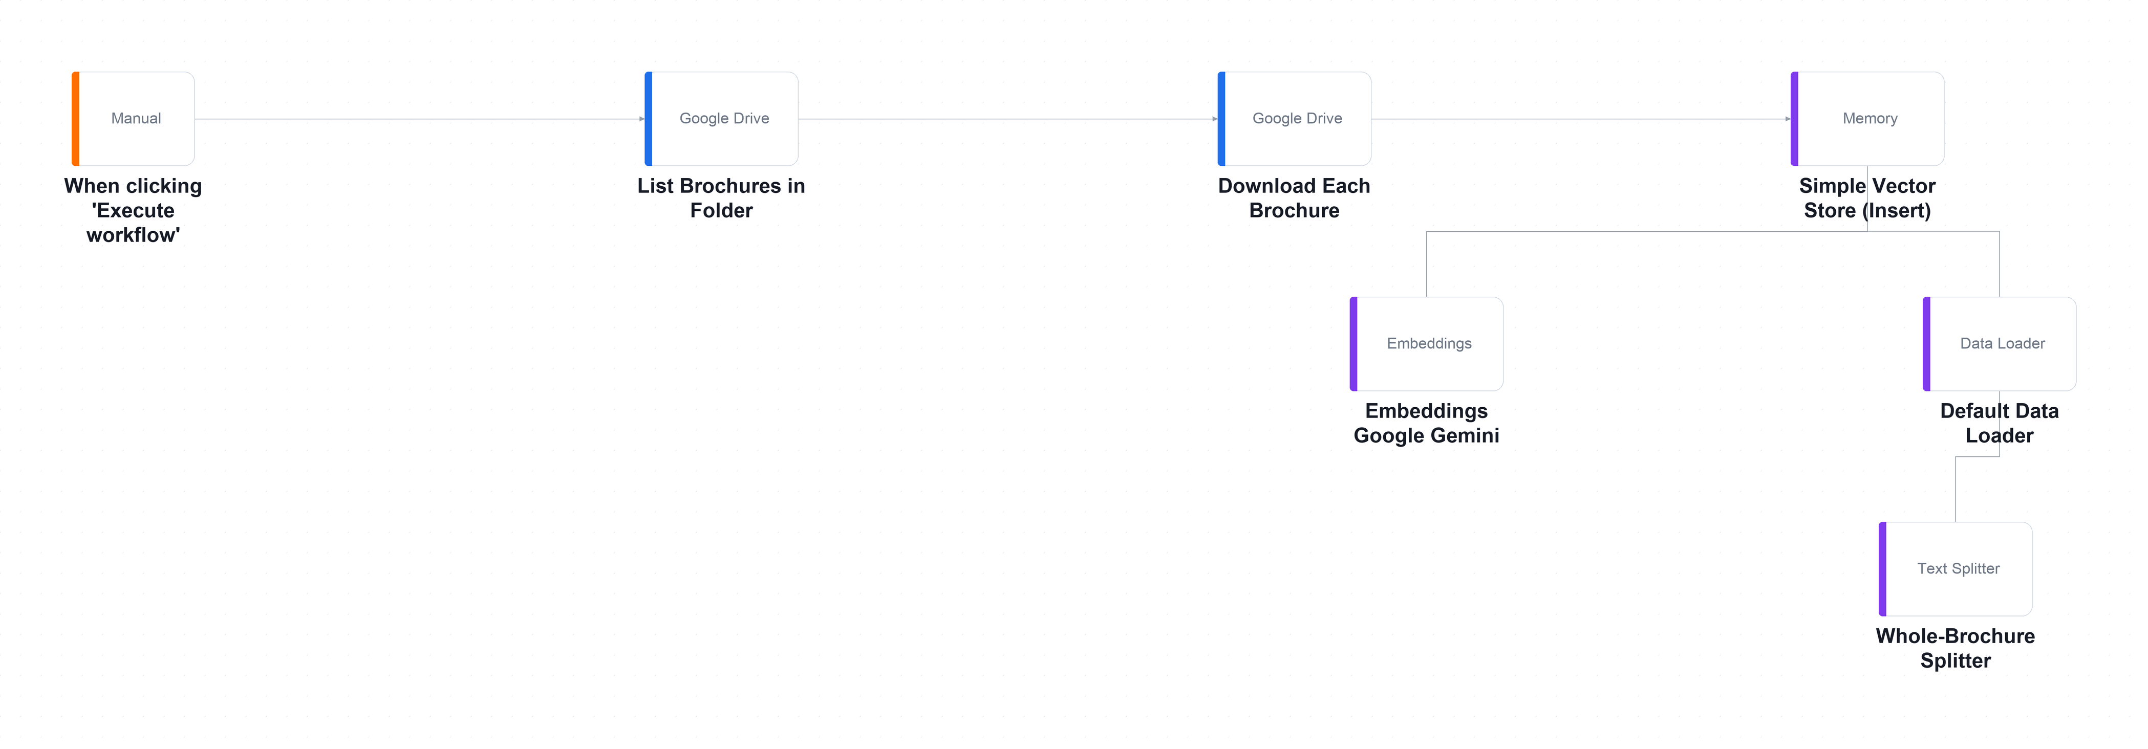
TOPIC 3 · RAG · LAB WORKFLOW
Lab 5 — RAG Customer Care Chatbot — Ingestion Workflow
Cook & Bake Academy's customer care team retypes the same answers all day, and every answer is already written in the course brochures.
Manual Trigger
you run ingestion once
Drive — list + download
20 brochures
Splitter
1 brochure = 1 chunk
Embeddings
3072-dim vectors
Vector Store — Insert
stored, ready to search
▶
▶
▶
▶
The ingestion workflow on the n8n canvas — run ONCE by hand. Twenty brochures are listed, downloaded, split, embedded and inserted into the vector store.
LAB 5
RAG Customer Care Chatbot — Ingestion Workflow
Ingestion: Drive → Split → Embed → Vector Store · Answering: Webhook → Agent + Retriever → Respond · full click-by-click steps in the Learner Guide
Automate Business Processes with Agentic AI Workflows · C209
© 2026 Tertiary Infotech Academy Pte Ltd
80

Slide 81
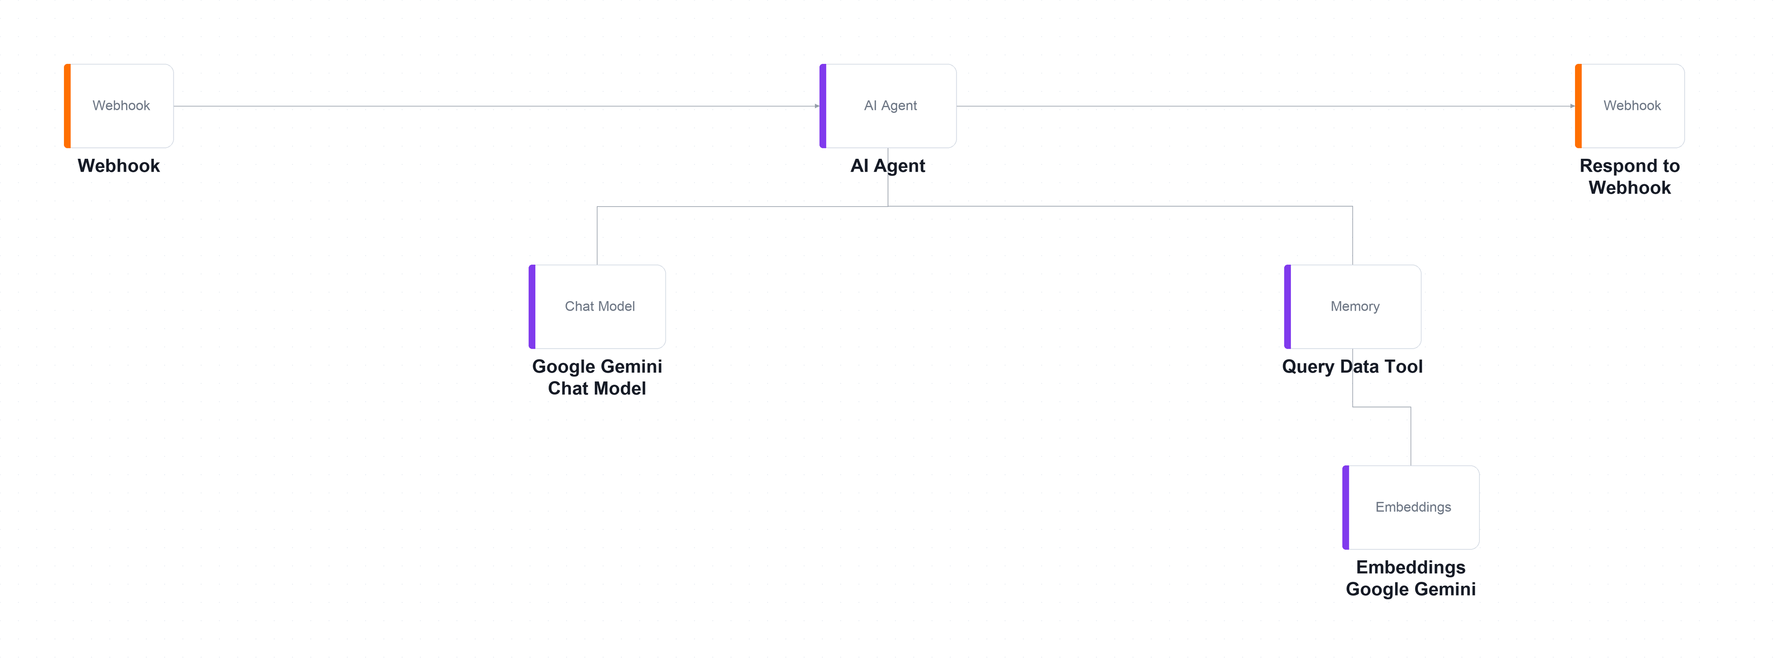
TOPIC 3 · RAG · LAB WORKFLOW
Lab 5 — RAG Customer Care Chatbot — Answering Workflow
The answering workflow on the n8n canvas — runs on EVERY question. The Query Data Tool and its embedding model hang below the agent.
Webhook — POST
a visitor asks a question
AI Agent
+ Query Data Tool
Retrieve
nearest brochures only
Respond
answer grounded in those
▶
▶
▶
LAB 5
RAG Customer Care Chatbot — Answering Workflow
Ingestion: Drive → Split → Embed → Vector Store · Answering: Webhook → Agent + Retriever → Respond · full click-by-click steps in the Learner Guide
Automate Business Processes with Agentic AI Workflows · C209
© 2026 Tertiary Infotech Academy Pte Ltd
81

Slide 82
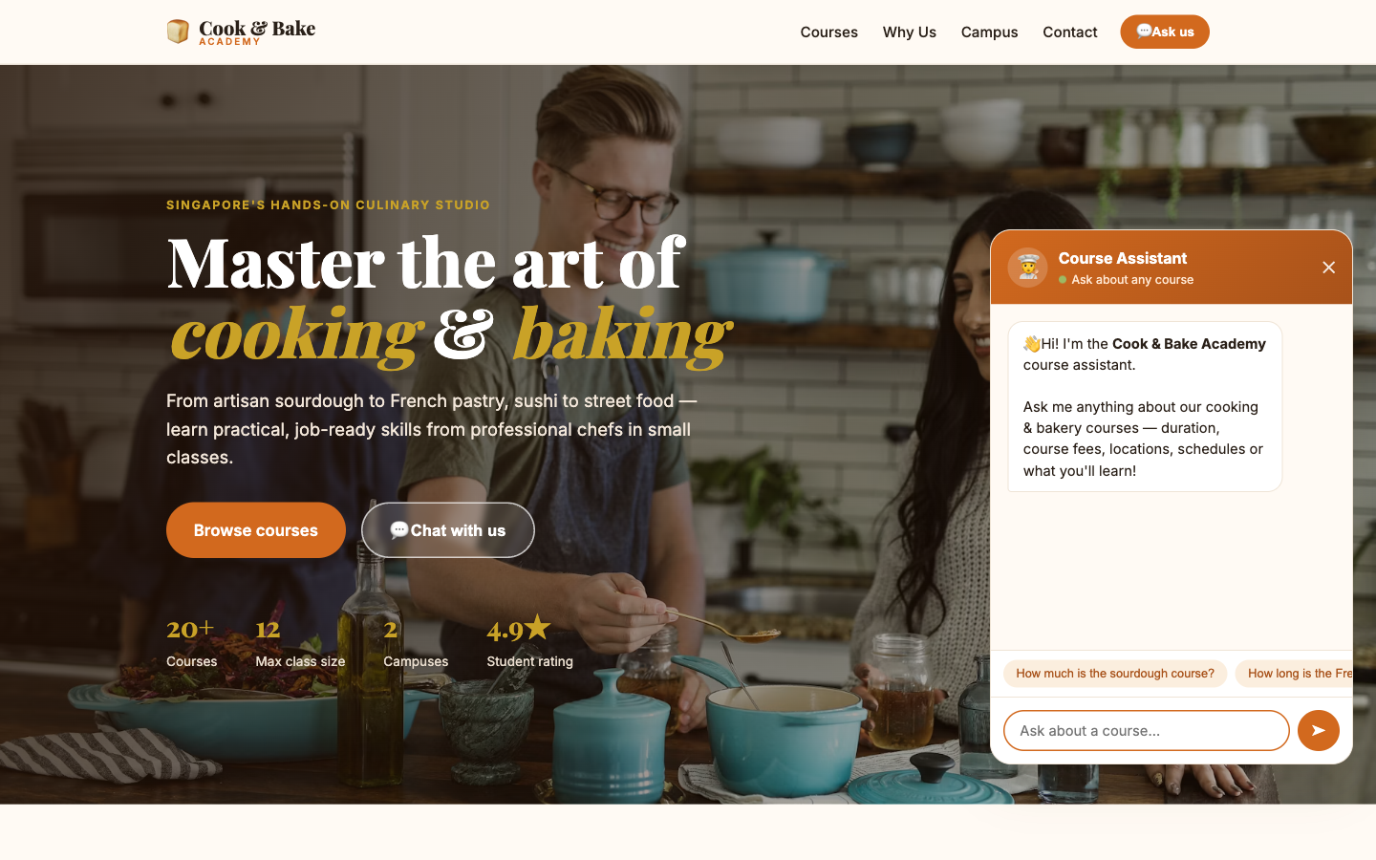
LAB 5 · THE APPLICATION
Lab 5 — RAG Customer Care Chatbot — What You'll Build
• The Cook & Bake Academy site with the course assistant open. Every answer it gives is grounded in the 20 brochures you ingested into the vector store.
• RAG retrieves the few documents that resemble the question instead of pasting everything into the prompt.
• An embedding places similar meanings close together, so retrieval works even when no words match.
Automate Business Processes with Agentic AI Workflows · C209
© 2026 Tertiary Infotech Academy Pte Ltd
82

Slide 83
LAB 5 · VERIFY AND DEBRIEF
Lab 5 — RAG Customer Care Chatbot
TC1 must quote BAK-101's exact fee from the brochure. Then run the three hallucination probes: TC7 (a course that does not exist), TC8 (an instructor name no brochure contains) and TC9 (a discount that was never offered). Any confident answer to these is a failure, however fluent.
1
What RAG does
2
Embeddings
RAG retrieves the few documents that resemble the question instead of pasting everything into the prompt.
An embedding places similar meanings close together, so retrieval works even when no words match.
3
Chunking
4
Match model and key
Chunking is the single biggest lever on RAG quality — the right chunk answers a question on its own.
The ingestion and retrieval embedding models must be identical, and the memory keys must match.
5
In-memory is temporary
n8n's Simple Vector Store is wiped when n8n restarts — fine for learning, unacceptable in production.
Lab 5 — you can now deploy a RAG application that grounds an agent in the organisation's own documents.
Automate Business Processes with Agentic AI Workflows · C209
© 2026 Tertiary Infotech Academy Pte Ltd
83

Slide 84
WRAP-UP
Course Summary & Next Steps
Automate Business Processes with Agentic AI Workflows · C209
© 2026 Tertiary Infotech Academy Pte Ltd
84

Slide 85
LEARNING OUTCOMES
What You Achieved
1
LO1 · n8n and AI agents
Built a trigger-and-action workflow and explained how an LLM agent differs from generative AI.
2
LO2 · Webhook-triggered agents
Put an AI agent behind a real website, with tools, structured output and an audit log.
3
LO3 · Agentic chatbots
Designed a chatbot that collects contact details and refuses to give regulated advice.
4
LO4 · Human in the loop
Paused a workflow on an approval gate so no drafted communication was sent unsupervised.
5
LO5 · RAG
Ingested 20 documents into a vector store and grounded a chatbot so it stopped inventing answers.
Automate Business Processes with Agentic AI Workflows · C209
© 2026 Tertiary Infotech Academy Pte Ltd
85

Slide 86
NEXT STEPS
Taking This Back to Work
Six moves that turn what you built this week into something your organisation actually runs.
1
Start with one painful process
2
Map it before you build it
3
Decide where the human belongs
Pick something repetitive, high-volume and low-risk. Automate that first.
Draw the trigger, the decisions and the actions on paper. The canvas comes second.
Anything irreversible, regulated or expensive keeps an approval gate.
4
Ground the agent in your own data
5
Log everything from day one
6
Iterate with real cases
RAG over your policies and documents beats a general model every time.
You will need the audit trail long before you think you will.
Test with the questions you fear, not the ones you hope for.
The next process you automate is the one you were dreading this morning.
Automate Business Processes with Agentic AI Workflows · C209
© 2026 Tertiary Infotech Academy Pte Ltd
86

Slide 87
WE'RE HERE TO HELP — DURING AND AFTER THE CLASS
Support
Email
enquiry@tertiaryinfotech.com
Telephone
+65 6100 0613
1
2
Website
www.tertiarycourses.com.sg
LMS / TMS portal
lms-tms.tertiaryinfotech.com
3
4
Automate Business Processes with Agentic AI Workflows · C209
© 2026 Tertiary Infotech Academy Pte Ltd
87

Slide 88
COURSE FEEDBACK
Your Feedback Matters
Tell us how it went
Complete the pricedback form shared by your trainer.
What we use it for
Your comments shape the pacing, the labs and the depth of each topic.
1
2
Talk to your trainer
Raise anything during class — you do not have to wait for the form.
Stay in touch
Email enquiry@tertiaryinfotech.com with follow-up questions any time.
3
4
Automate Business Processes with Agentic AI Workflows · C209
© 2026 Tertiary Infotech Academy Pte Ltd
88

Slide 89
HAPPY AUTOMATING
Thank You!
Keep your n8n instance running and keep building. The next process you automate is the one you were dreading this morning.
Automate Business Processes with Agentic AI Workflows · C209
© 2026 Tertiary Infotech Academy Pte Ltd
89

